Slide 1
Harry Potter Trivia Maze
Team HardMode:
Kayla Foremski, Calum Mackenzie, and Roon Le

Slide 2
Overview
C# .NET Framework using Visual Studio WPF
4x4 Maze
Harry Potter House-themed Trivia Question

Slide 3
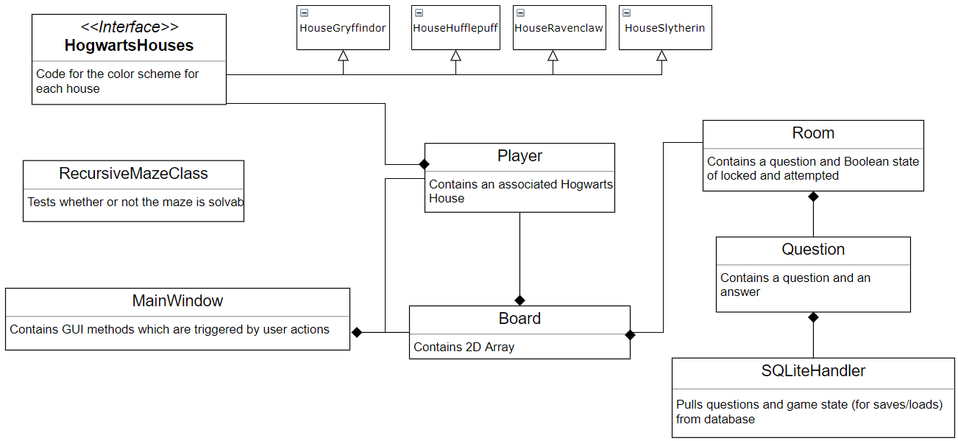
UML Diagram

Slide 4
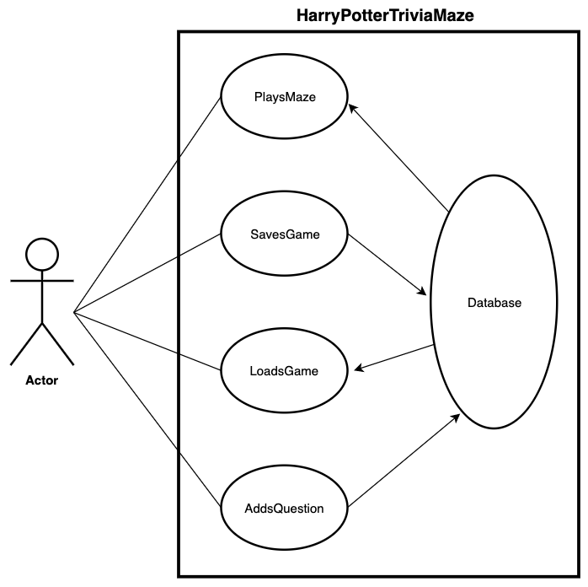
Use Case Diagram

Slide 5
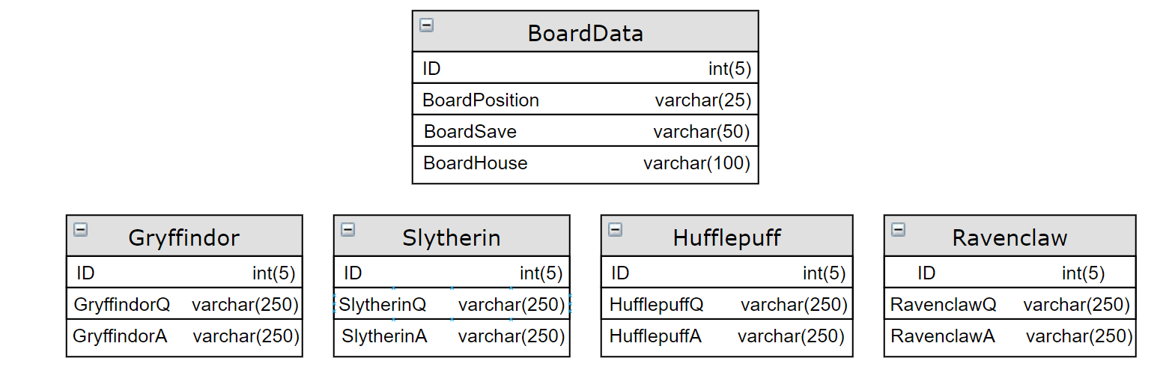
SQLite Database Schema

Slide 6
Difficulties Encountered
Learning C# and how to use Visual Studio WPF
Refactoring code
Ensuring all group members were on the same page with logic/maze design

Slide 7
Program Demo

